Slide 1
Oracle Cloud Infrastructure Security
Der Praxis Workshop
Martin Berger
Stefan Oehrli

Slide 2

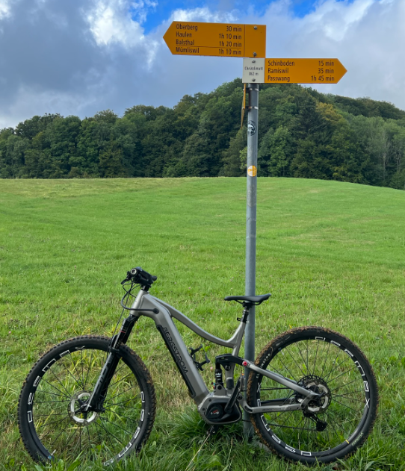
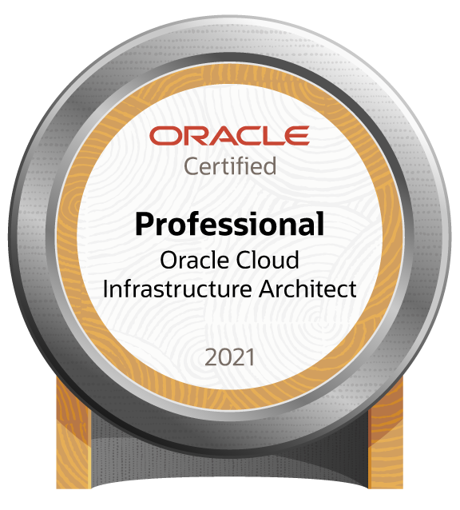

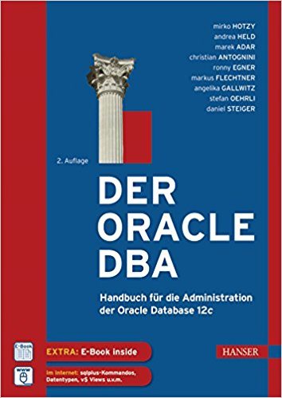


Martin Berger – Modern Data Platforms
Modern
Data
Platforms
stefan.oehrli@accenture.com
Tech Architecture Manager
Since 1998 working in IT
More than 22 years of experience in Oracle databases
Kestenholz / Jurasüdfuss / Switzerland
2 Junior-DBAs @ Home (8yrs & 10yrs)
Firefighter & E-Biker
Loves his companies' cultural values:
curiosity, doers, network, space, and together
Focus: Let’s go into the Cloud!
Co-author of the book The Oracle DBA (Hanser, 2016/07)
martinberger.com
@martinberger_ch

Slide 3


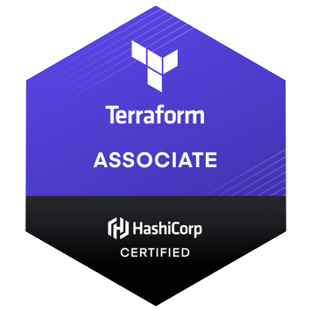

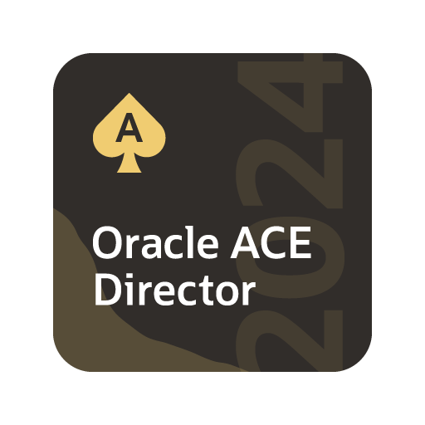

Stefan Oehrli – Modern Data Platforms
Modern
Data
Platforms
stefan.oehrli@accenture.com
Tech Architecture Manager
Since 1997 active in various IT areas
More than 25 years of experience in Oracle databases
Focus: Protecting data and operating databases securely
Security assessments and reviews
Database security concepts and their implementation
Oracle Backup & Recovery concepts and troubleshooting
Oracle Enterprise User and Advanced Security, DB Vault, …
Oracle Directory Services
Co-author of the book The Oracle DBA (Hanser, 2016/07)
oradba.ch
@stefanoehrli

Slide 4








450+ technical experts helping peers globally
The Oracle ACE Program recognizes and rewards community members for their technical and community contributions to the Oracle community
3 membership tiers
Nominate yourself or someone you know:
ace.oracle.com/nominate
For more details on Oracle ACE Program:
ace.oracle.com
Connect:
aceprogram_ww@oracle.com
Facebook.com/OracleACEs
@oracleace
Oracle ACE Program Group

Slide 5


3 key benefits
Modern Data Platforms VISON & MISSION
WHY? We are the game changer for our client's data platform projects
HOW? Maximum automation, maximum efficiency, maximum quality!
WHAT? We build innovative data platforms based on our blueprints and licensable assets and tools.
1 Architecture expertise from hands-on projects
2 Delivery of tailor-made data platforms
3 Integrated Teams - Like a rowing team, perfect alignment and interaction.
Tools and Blueprints
Continuous Optimization
Expertise & Light Towers
Key enabler for the implementation of modern data platforms at a high speed and quality.
Tools and Blueprints are continuously optimized to the customer and project’s needs.
Expert group for modern data platforms from technical implementation to project management and organization

Slide 6
Cloud Guard
1
Introduction
2
SQL Firewall
A new approach to protect your data.
3
CLI Management
4
GUI Management
5
Reporting, Audit and Alerts
6
Licensing
7
Challanges
8
Conclusion

Slide 7
Understanding Cloud Guard
1
What about the Database Security?

Slide 8
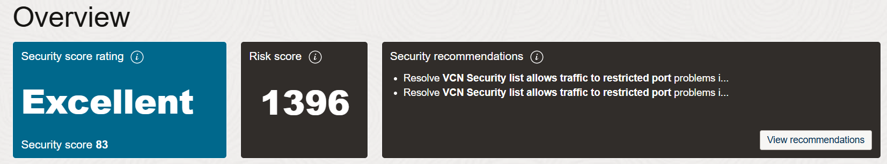
What is Cloud Guard?
Oracle Cloud Guard is a cloud-native service designed to help customers monitor, identify, and maintain a strong security posture on Oracle Cloud Infrastructure. It continuously examines OCI resources for security weaknesses related to configuration and user activities
Real-Time Threat Detection
Automated Risk Assessment
Customizable Security Policies
Cloud Guard provides real-time monitoring and threat detection by continuously scanning OCI resources for misconfigurations, vulnerabilities, and anomalous activities. This ensures that potential security issues are identified and addressed promptly
Cloud Guard automatically assesses security risks based on predefined security policies and industry standards, such as the CIS Benchmark. It offers actionable recommendations for addressing detected risks, allowing for quick remediation and enhancing overall security
Users can configure custom policies and rules to align monitoring with their specific security requirements. Cloud Guard integrates seamlessly with other OCI tools, providing a comprehensive and flexible security solution.

Slide 9
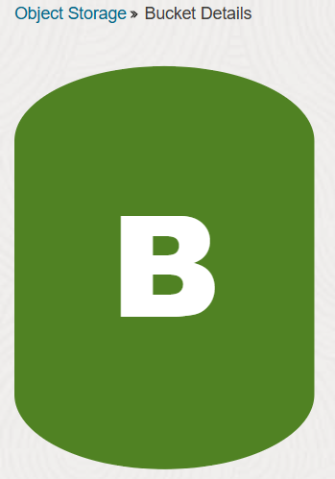
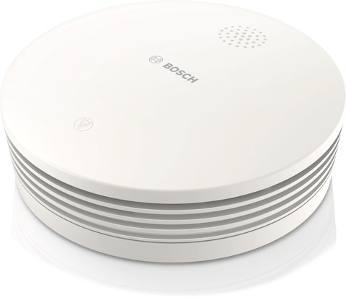


Key Components of Cloud Guard
Targets
Targets define the scope of what Cloud Guard is to check. This scope is tied to the compartment where the target is defined and all the child compartments from that point until another target is encountered. Compute Instances, Object Storage etc.
Detectors
Detectors perform checks and identify potential security problems based on their type and configuration.
Responder Recipes
These provide the baselines for examining the resources and activities in the target. Oracle-managed detector recipes allow setting only the scope of resources for which a rule triggers a problem, while user-managed detector recipes allow more customization.
Detector Recipes
Responder recipes define the actions to be taken when a problem is detected. They can be configured to automatically remediate security issues or to notify administrators for manual intervention.

Slide 10


How Cloud Guard works
Target
Detectors
Problems
Responder
Object Storage Bucket
Visibility Public
Mail Notification
Change Visibility
Security List
0.0.0.0/0
Stream Information
Remove Rule
Compute Instance
Public IP
Slack Channel
Shutdown
Data Collection and Analysis
Alert
Remediation

Slide 11
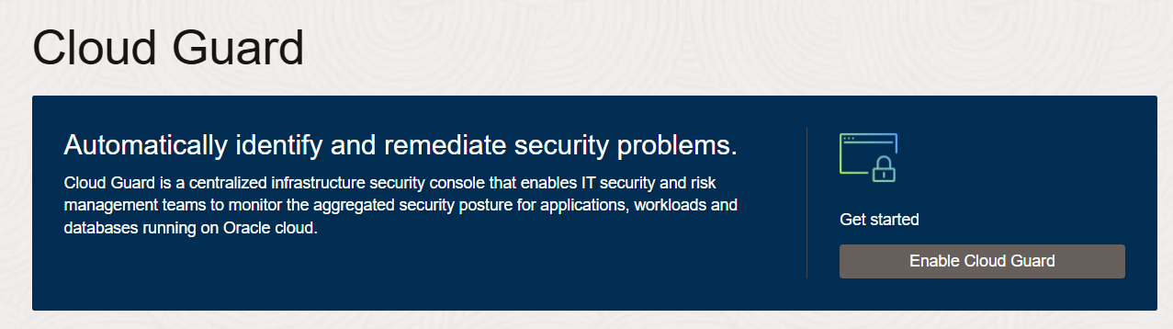
Enable Cloud Guard
The prerequisites for enabling Oracle Cloud Guard:
Having a paid Oracle Cloud Infrastructure tenancy, as Cloud Guard is not available for free tenancies.
Users must create a user group with administrator privileges to work with Cloud Guard, and this group should be restricted to a limited audience.
Additionally, specific policy statements must be added to enable the Cloud Guard users group to manage Cloud Guard resources.

Slide 12
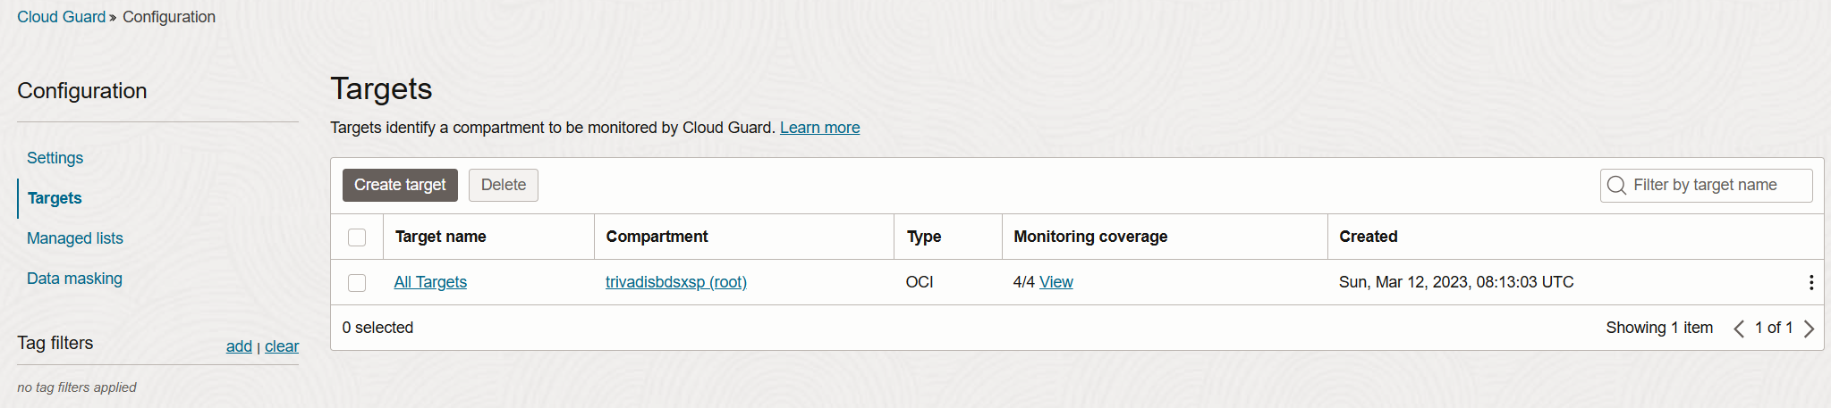
Setting Up Cloud Guard Targets
Defines the resources where Cloud Guard is enabled.
Setting up more targets allows more specific monitoring
OCI Cloud Guard service targets are logical objects inspected by Cloud like Compute Instance, Object Storage Bucket, Security Lists etc.
Rules to detect and resolve issues are applied to targets.

Slide 13
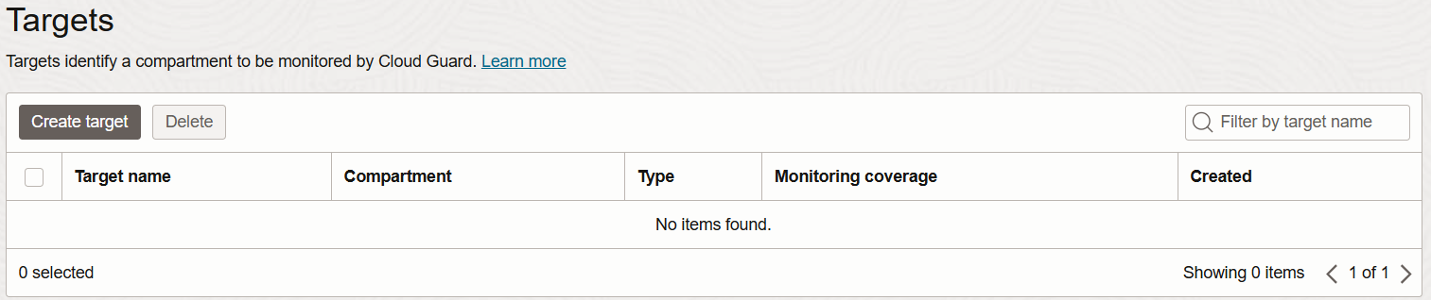
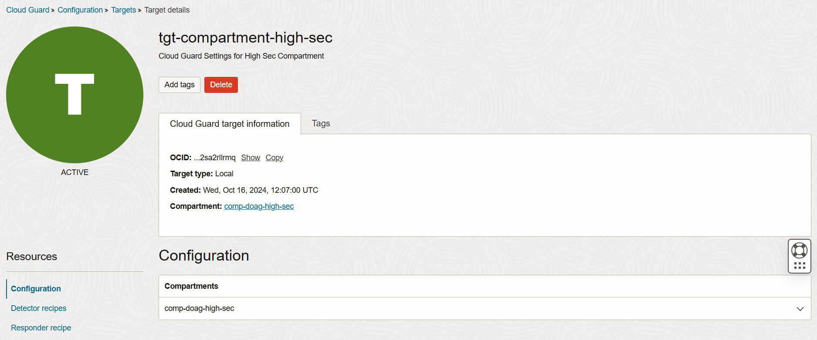
Targets Inside
You don’t see the new created target for a compartment in the configuration list? Search it via Tenacy Explorer or Search Bar.

Slide 14
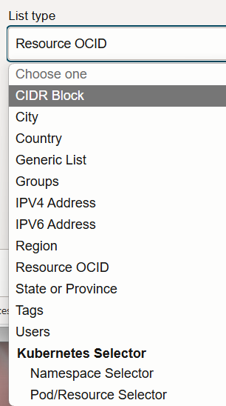
Managed Lists
A managed list is a reusable set of parameters that simplifies setting the scope for detector and responder rules. It can be used to apply specific configurations to detectors.
For example, a predefined "Trusted Oracle IP address space" list includes all Oracle IP addresses you want to consider trusted when defining rules for detectors and responders.
Cloud Guard also allows you to create your own managed lists as needed, such as lists of states or provinces, zip or postal codes, OCIDs, or any other criteria you require.
Here are some specific use cases for custom managed lists:
Trusted IP addresses: Exempt listed IP addresses from triggering alerts that should only be triggered by untrusted IP addresses.
Resources that should be public: Exempt listed resources from all detectors related to identifying public configurations.

Slide 15
Detection or Responding
Detector Recipes
These recipes are used to identify potential security issues by continuously monitoring resources for misconfigurations, vulnerabilities, and anomalous activities.
Detector recipes contain rules that define what constitutes a problem. When these rules are triggered, Cloud Guard creates a problem.
Responder Recipes
These recipes define the actions to be taken when a problem is detected by a detector recipe.
Responder recipes contain rules that specify the actions to remediate, resolve, or dismiss the identified problems.
Oracle provides a set of recipes (3+1) – you can clone then for adaption according your security needs.

Slide 16
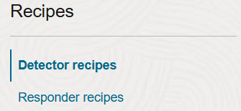
Detector Recipes
OCI Configuration Detector Recipe
Designed to detect resource configuration settings that could pose a security problem.
Helps identify misconfigured resources to ensure compliance with security policies.
OCI Instance Security Recipe
Monitors compute hosts for suspicious activity, providing runtime security for workloads in Compute virtual and bare metal hosts.
Collects important security information such as security alerts, vulnerabilities, and open ports to provide actionable guidance for detection and prevention.
OCI Activity Detector Recipe
Detects actions on resources that could pose a security problem.
Monitors activities to identify potential security issues based on resource actions.
OCI Threat Detector Recipe
Designed to detect subtle patterns of activity that could be building up to pose a security problem.
Continuously monitors OCI audit events for malicious activity using machine learning-based behavioral attack models.

Slide 17
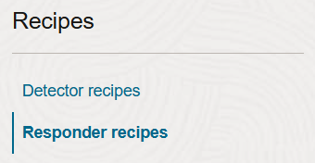
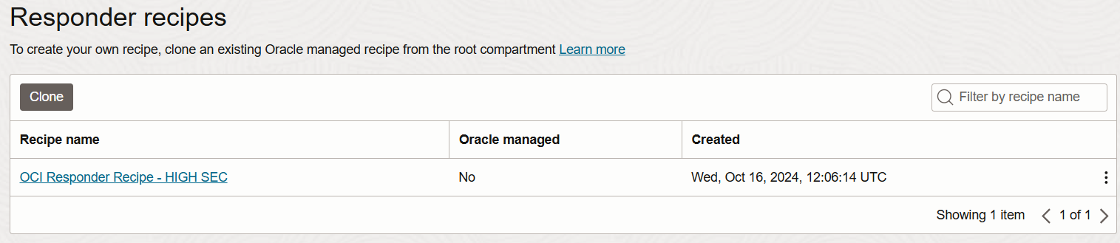
Responder Recipes
Define actions to be taken when a problem is detected by a detector recipe.
Can be configured for automatic remediation or to notify administrators for manual intervention.
Contain multiple responder rules specifying actions to address identified problems.
Can use Oracle-managed recipes with default rules or customized user-managed recipes.

Slide 18
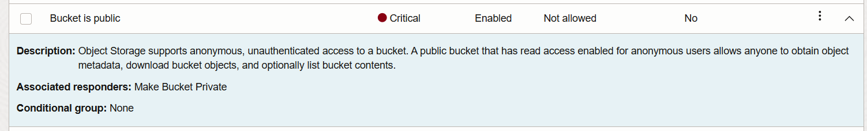
Auto-Resolve
This is configured on level targets according the Responder rules.
Requires an IAM policy to allow Cloud Guard the action.
The Detector and Responder rule must be enabled.
Allow service cloudguard to manage buckets in compartment
comp-doag-high-sec

Slide 19
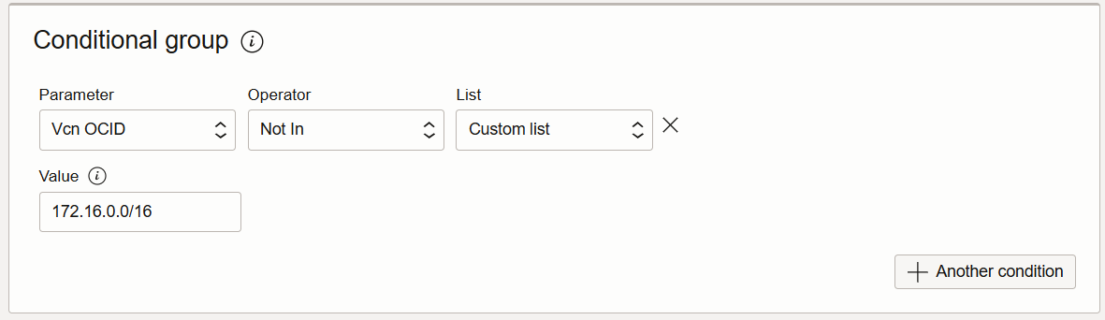
Conditional Execution
Key points about the conditional execution of a responder recipe:
Specify conditions under which a responder rule will be executed.
Define conditional groups with parameters like region, resource type, or tags.
The rule is enforced only if all conditions in the group are met.
Helps create precise, context-aware security responses, reducing unnecessary actions.

Slide 20
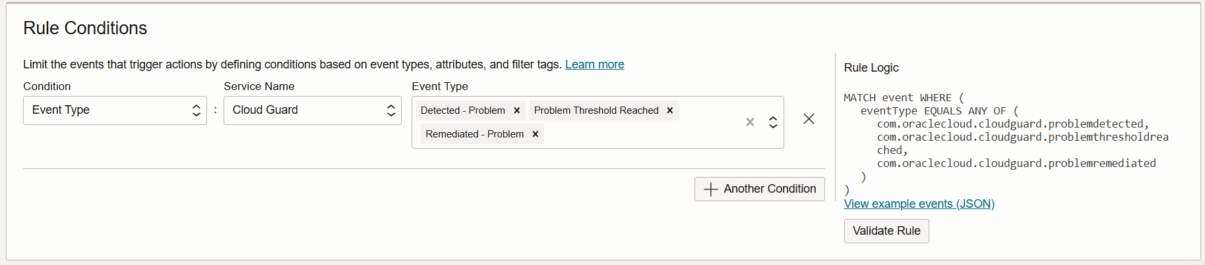
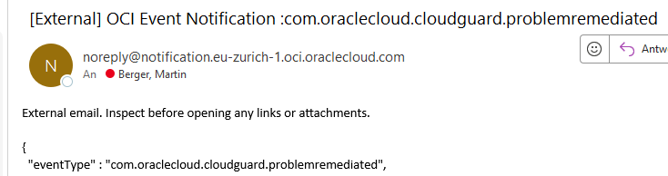
Notification
Be informed whenever Cloud Guard has detected or auto-resolved the problem by definig Rules.

Slide 21
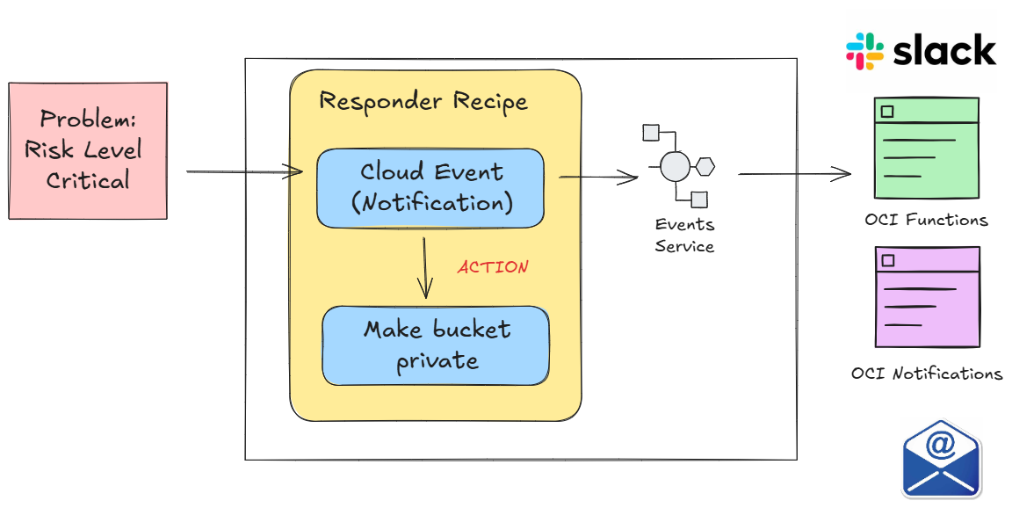
Notification

Slide 22
Practical Use Cases
2
What about the Database Security?

Slide 23
Use Case: Detecting Misconfigured Resources

Slide 24
Use Case: Monitoring Insecure Activities

Slide 25
Use Case: Automated Remediation

Slide 26
Advanced Topics
3
What about the Database Security?

Slide 27
Integrating Cloud Guard with Other OCI Services
Integration with OCI Events, Notifications, and Functions1

Slide 28
Best Practices for Using OCI Cloud Guard

Slide 29
Hands-On Labs
4
What about the Database Security?

Slide 30
Lab 1: Enabling and Configuring Cloud Guard

Slide 31
Lab 2: Creating and Customizing Detector Recipes

Slide 32
Lab 3: Creating and Customizing Responder Recipes

Slide 33
Lab 4: Monitoring and Managing Security Posture

Slide 34
Conclusion
5
What about the Database Security?

Slide 35
Summary and Key Takeaways

Slide 36
Resources
Cloud Guard Quick Start Guide | Oracle

Slide 37
Thank You

